Slide 1
Python errors
Traceback = sequence of function calls that led to an error.
Demo: debugging_Python.ipynb
source
Notes:
https://swcarpentry.github.io/python-novice-inflammation/reference/#traceback
https://swcarpentry.github.io/python-novice-inflammation/07-errors/

Slide 2
Project tip: EDA check lists
https://simplystatistics.org/2015/03/03/the-elements-of-data-analytic-style-so-much-for-a-soft-launch/
https://data-knowledge.blogspot.com/2016/05/exploratory-data-analysis-checklist.html
Which summarizes
https://bookdown.org/rdpeng/exdata/exploratory-data-analysis-checklist.html
See also
https://www.stat.cmu.edu/~hseltman/309/Book/chapter4.pdf

Slide 3
Load function from .py file in a .ipynb notebook
Demo: use_a_function_in_a_notebook.ipynb

Slide 4
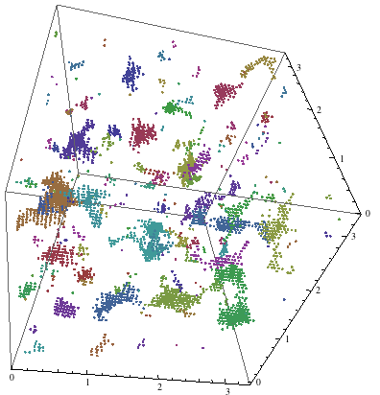
clustering numerical data; document clustering
Data 601
These notes are CC BY 4.0
Notes:
https://mathematica.stackexchange.com/questions/32738/clustering-3d-data-points-on-a-periodic-cubic-grid

Slide 5

Course schedule and outline (scope)
: Overview of Data Science
: Python in Jupyter
: Getting data
: Data cleanup
: Automation; Reports
: Project 1 presentations
: Math
: time series
: Clustering
: Tables, Graphs
: Project 2 – reproducibility
: Concurrency, Elasticity, Cost/Benefit
: Final project presentations

Slide 6

Customer didn't think it was possible, so they didn't bother asking
Notes:
https://kramers.com/story-time

Slide 7
Outcomes for this evening
By the end of today's class, you should be able to do the following:
Load function from .py file in a .ipynb notebook
Explain difference between agglomerative and divisive clustering
Use k-Means to identify subsets of data
Identify common "stop words"
Write simple regular expressions

Slide 8

Clustering context
Clustering context
Applications of clustering
Clustering methods
Clustering numerical data

Slide 9
Linear regression: fit data for multiple purposes
Extrapolation = independent variable (x) being evaluated is outside the range of values you already have information on
Interpolation = value you are evaluating is within the range of values you already know
--> Supervised machine learning
Notes:
https://www.quora.com/What-is-the-difference-between-linear-extrapolation-and-linear-regression

Slide 10
Map of Machine Learning topics
Machine Learning
Reinforcement learning
For every inference, you are told how good of an answer you gave, but not what the correct answer was.
Supervised
User provides "right answer" as example data
Unsupervised
No labeled data provided
Regression
Predict real valued output
Classification
Predict discrete valued output
clustering
Linear
regression
Logistic
regression
Decision
tree
Neural
network (DL)
k-Nearest
Neighbors (kNN)
Notes:
http://www.cs.princeton.edu/courses/archive/spr11/cos435/Notes/clustering_intro_kmeans_topost.pdf

Slide 11
Machine Learning
Unsupervised
No labeled data provided
clustering
For a better overview tree, see
Techniques of Cluster Algorithms in Data Mining
October 2002; Data Mining and Knowledge Discovery 6(4):303-360
DOI: 10.1023/A:1016308404627
Hierarchical
clustering
Partitional
clustering
Divisive
Agglomerative
K-Means
Notes:
Techniques of Cluster Algorithms in Data Mining
October 2002; Data Mining and Knowledge Discovery 6(4):303-360
DOI: 10.1023/A:1016308404627
Images is from https://www.alanfielding.co.uk/multivar/ca.htm

Slide 12
Applications of Clustering
Clustering context
Applications of Clustering
Clustering methods
Clustering numerical data

Slide 13
Application for clustering: Search engine supplies similar topics
http://yippy.com/ is a metasearch site that groups results into "nearby" topics
Activity: in your web browser, go to yippy.com and search for data science
Notes:
https://www.hindawi.com/journals/tswj/2015/931258/

Slide 14
Application for clustering: Customer or Market segmentation
important for optimization of marketing strategies.
Examples: a story that is relevant to a farmer may not resonate with city dwellers; a story for students may not apply to retired people
Outcome: Better targeting of consumers through behavioral analysis of purchases, timing, which channel gets accessed, customer attributes
https://en.wikipedia.org/wiki/Market_segmentation#Bases_for_segmenting_consumer_markets
Notes:
https://www.kaggle.com/nafisur/customer-segmentation-analysis-cluster-analysis

Slide 15
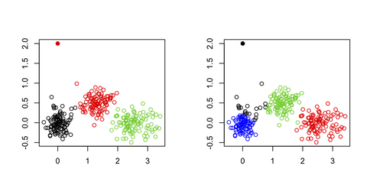
Application for clustering: Detecting anomalies
Group valid activity to enable
outlier detection
Monitoring whether a data point switches between groups over time can be used to detect meaningful changes in the data.
source
https://www.infoq.com/presentations/scale-anomaly-detection-framework/
Notes:
https://www.datascience.com/blog/k-means-clustering

Slide 16
Clustering methods
Clustering context
Applications of Clustering
Clustering methods
Clustering numerical data
Notes:
For a more comprehensive overview, see
https://www3.nd.edu/~rjohns15/cse40647.sp14/www/content/lectures/13%20-%20Hierarchical%20Clustering.pdf

Slide 17
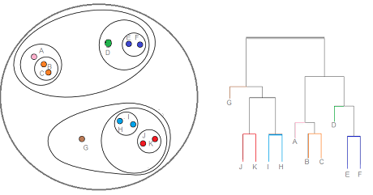
Clustering approaches
Partitional algorithms: Construct various partitions and then evaluate them by some criterion
Hierarchical algorithms: Create a hierarchical decomposition of the set of objects using some criterion
(Dendrogram)
Notes:
Text is from https://www.cs.cmu.edu/~tom/10601_fall2012/slides/clustering.pdf
overview: https://youtu.be/Xvwt7y2jf5E
Image is from https://www.statisticshowto.com/hierarchical-clustering/

Slide 18
Clustering approaches
Partitional algorithms: Construct various partitions and then evaluate them by some criterion
Hierarchical algorithms: Create a hierarchical decomposition of the set of objects using some criterion
Bottom-up (Hierarchical Agglomerative Clustering): starting with isolated points, merge two items at a time into a new cluster by calculating a dissimilarity between each merged pair and the other samples.
Top-down (Hierarchical Divisive Clustering): Starting with a single set, split into two distinct parts according to some degree of similarity.
Notes:
Text is from https://www.cs.cmu.edu/~tom/10601_fall2012/slides/clustering.pdf
Image is from https://www.statisticshowto.com/hierarchical-clustering/

Slide 19
Activity: Agglomerative and Divisive Clustering
Agglomerative clustering of students by number of letters in first name:
start with isolated students – spread out across the room virtually

Slide 20
Activity: Agglomerative and Divisive Clustering
Agglomerative clustering of students by number of letters in first name:
start with isolated students – spread out across the room
Each student – find a nearby student self-enroll to a group
For each pair of students, if first name length of each candidate pair is same the group can answer the activity question. If not, try joining another group, and repeat step 3.
If a group is formed, the group then identifies other students to query regarding name length
End state: groups of students, where members of each group have the same number of letters in their first name​
We will demonstrate divisive clustering later in this session

Slide 21
Clustering approaches
Partitional algorithms: Construct various partitions and then evaluate them by some criterion
"a division of the set of data objects into non-overlapping subsets (clusters) such that each data object is in exactly one subset"
Notes:
Text is from https://www.cs.cmu.edu/~tom/10601_fall2012/slides/clustering.pdf
Image is from https://www.statisticshowto.com/hierarchical-clustering/

Slide 22
Clustering numerical data
Clustering context
Applications of Clustering
Clustering methods
Clustering numerical data

Slide 23
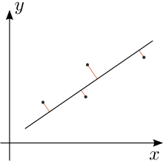
Activity: you already know how to cluster
Given a scatter plot and a guess for k, identify which points should be associated with k groups
X
X
X
X
Need a volunteer who is not in Data 602
and who has not previously heard of k-means
X
X

Slide 24
A formalized approach: K-means algorithm
Guess number of clusters, k
Guess location of cluster centers
Loop following until converged
Expectation step: assign points to the nearest cluster center using a distance measurement
Maximization step: set the cluster centers to the mean
Example distance measurement:
Residual Sum of Squares: minimize sum of squared distances of each point to its centroid
Notes:
http://www.cs.princeton.edu/courses/archive/spr11/cos435/Notes/clustering_intro_kmeans_topost.pdf
https://jakevdp.github.io/PythonDataScienceHandbook/05.11-k-means.html

Slide 25
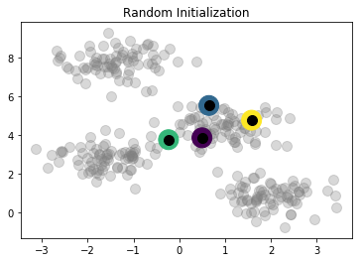
Demo: jakevdp_kmeans_iterations.ipynb
of centroid locations
[[ 0.49671415 3.8617357 ] [ 0.64768854 5.52302986] [-0.23415337 3.76586304] [ 1.57921282 4.76743473]]
Notes:
These static images are placeholders in case the live demo doesn't work

Slide 26
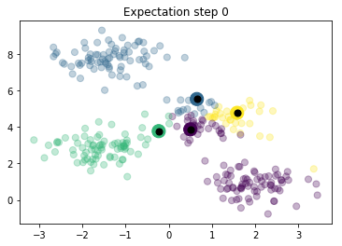
Identify which points are associated with centroids

Slide 27
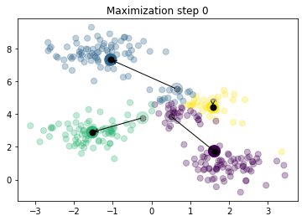
[[ 1.61788404 1.73021643] [-1.05544832 7.31289 ] [-1.53049092 2.89441674] [ 1.58028607 4.4210127 ]]

Slide 28
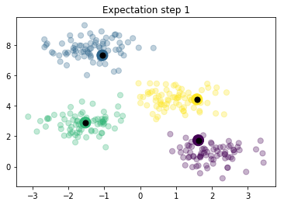
Identify which points are associated with centroids

Slide 29

[[ 1.98258281 0.86771314] [-1.37324398 7.75368871] [-1.57084703 2.85535402] [ 0.97007666 4.41532732]]

Slide 30
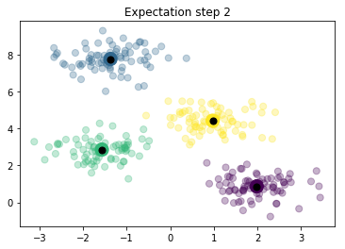
Identify which points are associated with centroids

Slide 31

[[ 1.98258281 0.86771314] [-1.37324398 7.75368871] [-1.58438467 2.83081263] [ 0.94973532 4.41906906]]

Slide 32
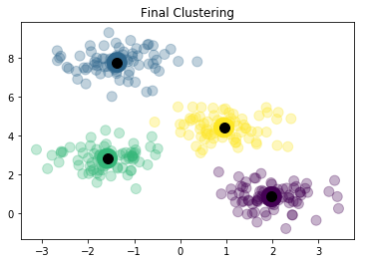
Based on convergence

Slide 33
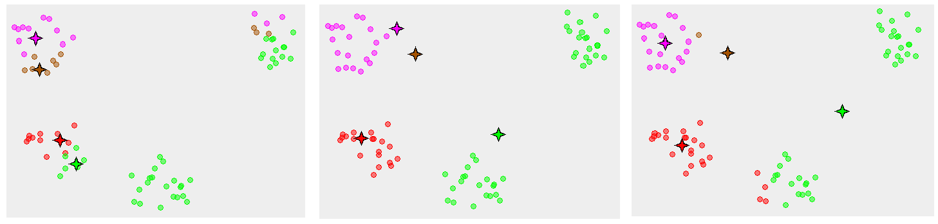
Avoid local minima by using multiple initial guesses for centroids
Guess #1
Guess #2
Guess #3

Slide 34
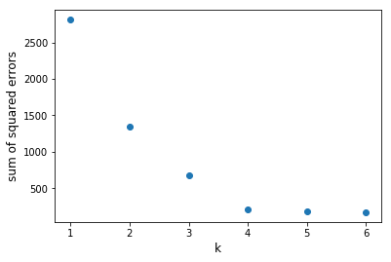
What k is best? Find the elbow
Compare within-cluster sum of squares for multiple k values
Caveat: this is a visual estimation method; fancier approaches are available
Demo: jakevdp_kmeans_iterations_elbow.ipynb

Slide 35
Given k clusters, how to identify labels?
Options:
summarize the distribution of attribute values
learn a decision tree from the clusters; then the relevant attributes are identified by the decision tree model
Figuring out labels for data is challenging
Notes:
https://doi.org/10.1007/978-3-319-20910-4_2
Witschel H.F., Loo S., Riesen K. (2015) How to Support Customer Segmentation with Useful Cluster Descriptions. In: Perner P. (eds) Advances in Data Mining: Applications and Theoretical Aspects. ICDM 2015. Lecture Notes in Computer Science, vol 9165. Springer, Cham

Slide 36
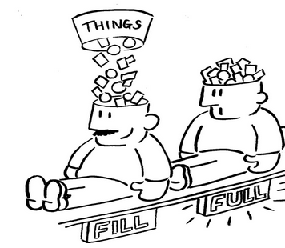
All done
Notes:
http://myemail.constantcontact.com/Is-your-brain-full-.html?soid=1105866149032&aid=fKlm9pjEiwk

Slide 37


Notes:
https://sayingimages.com/just-kidding-meme/

Slide 38
What if the data isn't numeric?

Slide 39
Suppose you have 1000 documents
Examples: web pages, PDFs, Word documents
Don't have time to manually read each
Can documents be clustered? By what attributes?
Metrics like word count, average word length probably aren't useful

Slide 40
Text Analysis
Clustering context
Applications of Clustering
Clustering methods
Clustering numerical data
Text Analysis
Finding patterns in Text
Cleaning text
Clustering Documents
Homework

Slide 41

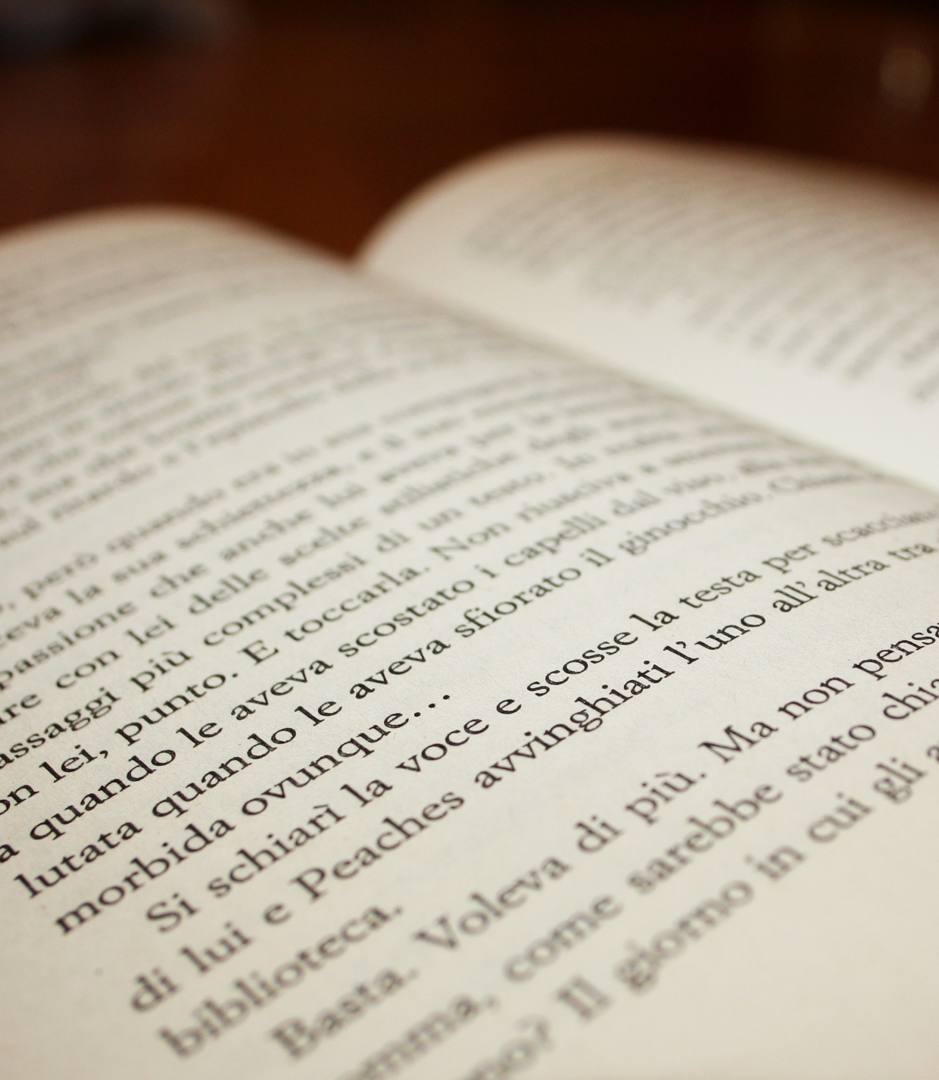
Written text is unstructured data
structured data typically has defined data types and is organized into patterns, making search and analysis easy
Unstructured data lacks data types and patterns
(There's also semi-structured data, e.g., JSON and XML.)
Notes:
https://www.quora.com/What-are-Structured-semi-structured-and-unstructured-data-in-Big-Data

Slide 42
But what about grammatical rules? Spelling?
Natural language (ie English, Spanish, Hindi, Mandarian) each have rules for construction.
Rules have exceptions.
Spelling has variations.
Spelling can be incorrect.
Mapping human communication to machine understandable content is the domain of Natural Language Processing
Notes:
https://stanfy.com/blog/natural-language-processing-why-the-machines-still-struggle-to-understand-us/
https://math.stackexchange.com/questions/170902/why-cant-we-use-memoization-to-parse-unambiguous-context-free-grammars-in-linea

Slide 43
A quick example
Claim: sentences end with a period.
--> to split a document into sentences, simply split the string on periods.
Example:
"This is a fun description of nothing. Another example of sound is provided by my radio. The rug is red.”
How many sentences are present in the example?

Slide 44
A quick example of the complexity
Claim: sentences end with a period.
--> to split a document into sentences, simply split the string on periods.
Another example:
"My doctor is Dr. Stark who knows stuff, e.g., medicine, is smart. I apply the K.I.S.S. principle: Keep It Simple, Stupid."
The naïve approach isn't sufficient.
Notes:
https://en.wikipedia.org/wiki/KISS_principle
How about “Panda Eats Shoots and Leaves”?

Slide 45
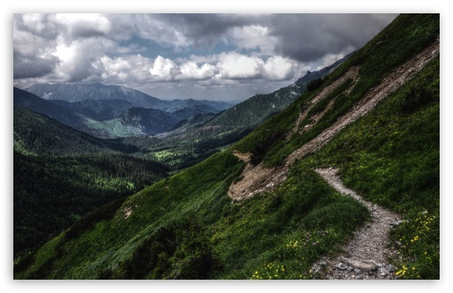
Natural Language Processing:
Text, Audio, Images
Notes:
The verbal overview of this slide is that
"The previous slides were intended to provide a view on the complexity of text-based analysis.
There's a well-traveled path of natural language processing."
Source: http://wallpaperswide.com/mountain_path-wallpapers.html

Slide 46
Finding patterns in text
Clustering context
Applications of clustering
Clustering methods
Clustering numerical data
Text Analysis
Finding patterns in Text
Cleaning text
Clustering Documents
Homework

Slide 47
Activity: Find a string in a text document
Go to https://library.umbc.edu/
Search the page using "ctrl + f"
Search for the string "loan"
Notes:
Verbal overview: this is the way (often the only way) that most folks are familiar with finding text
This is a big jump from the historical method of indexing a book

Slide 48
Find a string in a text document
Go to https://library.umbc.edu/
Search the page using "ctrl + f"
Search for the string "loan"
(rhetorical questions)
What if we needed to find every email address in a document?
What if we needed to find every phone number in a document?

Slide 49
Patterns in text
We are familiar with email addresses: aok@umbc.edu
Phone numbers look something like 410-455-2232

Slide 50
Describing Patterns in text
We are familiar with email addresses: aok@umbc.edu
A sequence of letters or numbers, then @, then more letters and numbers, a period, and two or more letters.
Phone numbers look something like 410-455-2232
Three numbers, a space or dash, three numbers, a space or dash, then four more numbers.

Slide 51
Regular Expressions
Symbolic way to represent digits: \d
Then phone number: \d\d\d-\d\d\d-\d\d\d\d\
Another way to represent digits: [0-9]
Demo: introduction_to_regular_expressions.ipynb

Slide 52
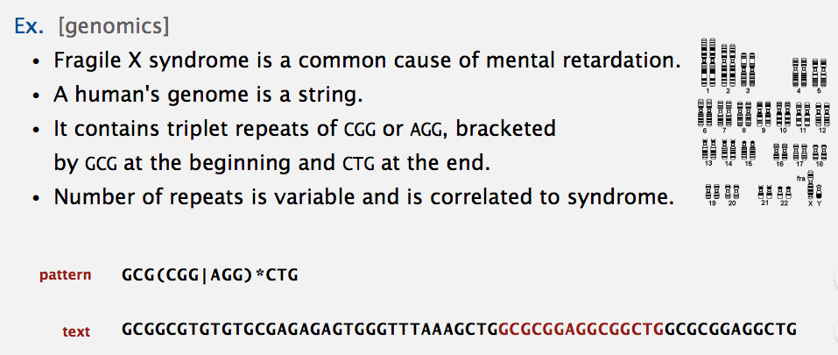
RegEx apply where ever text exists
Notes:
https://algs4.cs.princeton.edu/lectures/54RegularExpressions.pdf

Slide 53
Regular Expression references
https://regexper.com/
https://regexr.com/
https://github.com/ziishaned/learn-regex
https://qntm.org/files/re/re.html
https://www.regexpal.com/
https://www.debuggex.com/
https://www.regular-expressions.info/
https://stackoverflow.com/tags/regex/info
https://regex101.com/
Cheatsheets:
https://ryanstutorials.net/regular-expressions-tutorial/regular-expressions-cheat-sheet.php
http://www.cbs.dtu.dk/courses/27610/regular-expressions-cheat-sheet-v2.pdf
https://www.cheatography.com/davechild/cheat-sheets/regular-expressions/

Slide 54
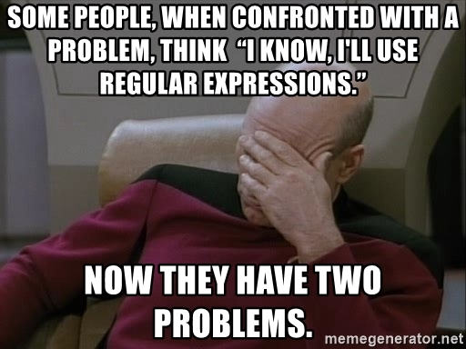
https://en.wikiquote.org/wiki/Jamie_Zawinski
Notes:
https://memegenerator.net/instance/14176209/picardfacepalm-some-people-when-confronted-with-a-problem-think-i-know-ill-use-regular-expressions-n
Comments from Jamie Zawinski:
Wow, I can’t believe you went to all this trouble over a .sig file! Anyway, a few comments:
First, I don’t know why none of that stuff is archived, I’ve never used X-No-Archive or anthing like it.
Second: yeah, I was repurposing the older “sed” quote, which I didn’t come up with myself, but that seemed appropriate as “sed” is where I learned regexps in the first place. (And I will pay Perl another backhanded complement: “it’s not as bad as sed.”)
Third: obviously I got Kelly’s joke about “streams of bytes”, uh, that’s why I quoted it. It’s funny, and it makes the point (which I fully agree with) that the decades-old Unix “pipe” model is just plain dumb, because it forces you to think of everything as serializable text, even things that are fundamentally not text, or that are not sensibly serializable.
Fourth: I like PostScript, and it’s a safe bet that I’ve written more and hairier PostScript by hand than anyone reading this… but the syntax is as close to “write-only” as in any language I’ve ever used. Anyone who defends PostScript as being “readable” is a monster raving loony.
Fifth: these days I use Perl a lot, but I still don’t like it. So there.

Slide 55
When RegEx is insufficient, use a parser
RegEx applies to Regular Languages
HTML is not a Regular Language
See also
https://stackoverflow.com/questions/6751105/why-its-not-possible-to-use-regex-to-parse-html-xml-a-formal-explanation-in-la
https://blog.codinghorror.com/parsing-beyond-regex/
https://stackoverflow.com/questions/11905506/regular-expression-vs-string-parsing
https://blog.honeybadger.io/replacing-regular-expressions-with-parsers/
Notes:
https://stackoverflow.com/questions/1732348/regex-match-open-tags-except-xhtml-self-contained-tags/1732454#1732454

Slide 56
Activity: Agglomerative and Divisive Clustering
Divisive clustering of students by number of letters in first name:
Starting with a single group, split into two distinct parts according to length of name (self-join into group 1 or 2), then one of you answer part 1 exercise
If you were in group 1 or 2, when part 2 exercise start, self-join into either group 1-1, 1-2, or 2-1, or 2-2 based on the number of letters in first name then one of you answer part 2 exercise
If you were in group 1-1, 1-2, 2-1 or 2-2, now you should self-join into groups such as 1-1-1, 1-1-2 then one of you answer part 3 exercise
End state: a set of groups of students, where members of each group should have the same number of letters in their first name

Slide 57
Cleaning text
Clustering context
Applications of clustering
Clustering methods
Clustering numerical data
Text Analysis
Finding patterns in Text
Cleaning text
Clustering Documents
Homework

Slide 58
Now that we know how to find complex strings in text,
How would we identify which words are relevant in a document?
Notes:
http://brandonrose.org/clustering
https://towardsdatascience.com/clustering-algorithms-for-customer-segmentation-af637c6830ac
https://www.datascience.com/blog/k-means-clustering
https://mubaris.com/2017/10/01/kmeans-clustering-in-python/

Slide 59
Activity: which words in this text are irrelevant?
I go to the store. A car is parked. Many cars are parked or moving. Some are blue. Some are tan. They have windows. In the store, there are items for sale. These include such things as soap, detergent, magazines, and lettuce. You can enhance your life with these products. Soap can be used for bathing, be it in a bathtub or in a shower. Apply the soap to your body and rinse. Detergent is used to wash clothes. Place your dirty clothes into a washing machine and add some detergent as directed on the box. Select the appropriate settings on your washing machine and you should be ready to begin. Magazines are stapled reading material made with glossy paper, and they cover a wide variety of topics, ranging from news and politics to business and stock market information. Some magazines are concerned with more recreational topics, like sports card collecting or different kinds of hairstyles. Lettuce is a vegetable. It is usually green and leafy, and is the main ingredient of salads. You may have an appliance at home that can quickly shred lettuce for use in salads. Lettuce is also used as an optional item for hamburgers and deli sandwiches. Some people even eat lettuce by itself. I have not done this. So you can purchase many types of things at stores.

Slide 60
Activity: which words in this text are irrelevant?
I go to the store. A car is parked. Many cars are parked or moving. Some are blue. Some are tan. They have windows. In the store, there are items for sale. These include such things as soap, detergent, magazines, and lettuce. You can enhance your life with these products. Soap can be used for bathing, be it in a bathtub or in a shower. Apply the soap to your body and rinse. Detergent is used to wash clothes. Place your dirty clothes into a washing machine and add some detergent as directed on the box. Select the appropriate settings on your washing machine and you should be ready to begin. Magazines are stapled reading material made with glossy paper, and they cover a wide variety of topics, ranging from news and politics to business and stock market information. Some magazines are concerned with more recreational topics, like sports card collecting or different kinds of hairstyles. Lettuce is a vegetable. It is usually green and leafy, and is the main ingredient of salads. You may have an appliance at home that can quickly shred lettuce for use in salads. Lettuce is also used as an optional item for hamburgers and deli sandwiches. Some people even eat lettuce by itself. I have not done this. So you can purchase many types of things at stores.

Slide 61
short words are less useful?
That naïve heuristic has exceptions:
Cat
Dog
Gun
Jon
Demo: nltk_for_text_processing.ipynb

Slide 62
Stop words
There are many lists of stop words available, i.e.
https://gist.github.com/sebleier/554280
http://xpo6.com/list-of-english-stop-words/
the specific list of stop words isn't priority

Slide 63
We can clean documents! Now what?
Next up: identifying words that are more unique to documents

Slide 64
Clustering Documents
Clustering context
Applications of clustering
Clustering methods
Clustering numerical data
Text Analysis
Finding patterns in Text
Cleaning text
Clustering Documents
Homework

Slide 65
Term Frequency-Inverse Document Frequency
TF-IDF makes rare words more prominent and
lowers dominance of common words.
Notes:
https://www.oreilly.com/library/view/feature-engineering-for/9781491953235/ch04.html

Slide 66
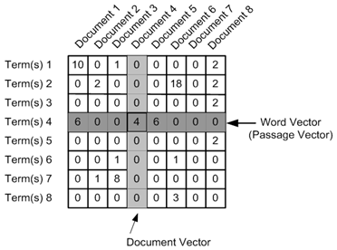
document-term matrix
Notes:
http://brandonrose.org/clustering

Slide 67
Term Frequency-Inverse Document Frequency
Demo: tfidf-textblob.ipynb

Slide 68
Topic modeling for unstructured text documents
LDA: Latent Dirichlet Allocation
https://www.analyticsvidhya.com/blog/2016/08/beginners-guide-to-topic-modeling-in-python/ https://www.machinelearningplus.com/nlp/topic-modeling-gensim-python/ https://towardsdatascience.com/topic-modeling-and-latent-dirichlet-allocation-in-python-9bf156893c24
https://rstudio-pubs-static.s3.amazonaws.com/79360_850b2a69980c4488b1db95987a24867a.html

Slide 69
Homework
Clustering context
Applications of clustering
Clustering methods
Clustering numerical data
Text Analysis
Finding patterns in Text
Cleaning text
Clustering Documents
Homework

Slide 70
Initial state for text analysis is raw text
Emails
Documents (PDF, TXT, DOCX)
Spreadsheets
Webpages
https://en.wikipedia.org/wiki/List_of_text_corpora

Slide 71
Remove stop words from txt and docx files
I provide a .zip containing .txt and .docx files
For each file, remove punctuation and stop words
Produce a single .dat file containing the name of the file in quotes, a colon, then a list of words separated by commas. The list of words per file should be unique for that file. Do not include URLs or phone numbers. Words should be made lowercase.
"File 1.txt" : word1, word2, word3, word7
"name of file.docx" : word8, word2, word1, word10
"another file.doc" : word1, word12, word6

Slide 72
Measurement of progress
When you are done with the assignment or have spent an hour on the homework (whichever comes first), please send me an email indicating which of these you have reached
To: jhwan@umbc.edu
Subject: Data 601 Fall 2020 Week 9 remove stop words
Content: "I have spent 1 hour on the homework" or "I am done with the assignment in 20 minutes."
If you've not completed the homework, please specify what your status is.

Slide 73
Reading assignment
Read Sections 1,2,3,6 of
http://opim.wharton.upenn.edu/~sok/idtresources/python/regex.pdf
Summarize what you learned in a half page (more than 100 words, less than 270).
Do not include your name.
Submit your text to me via Blackboard.
Submit the content as text.
Do not submit a docx or PDF or an image.

Slide 75
References
See chapter 4 in https://www-bcf.usc.edu/~gareth/ISL/ISLR%20Seventh%20Printing.pdf page 127
https://towardsdatascience.com/the-5-clustering-algorithms-data-scientists-need-to-know-a36d136ef68
https://mubaris.com/2017/10/01/kmeans-clustering-in-python/
http://brandonrose.org/clustering
https://jakevdp.github.io/PythonDataScienceHandbook/05.11-k-means.html
LDA using GenSim: https://towardsdatascience.com/topic-modeling-and-latent-dirichlet-allocation-in-python-9bf156893c24

